Slide 1

ITC 6000 Database Management Systems Final Project Presentation 2024 Term A Smart Management in Farming
Jainam Patel
patel.jainam1@northeastern.edu

Slide 2
Project Overview
Smart Management in Farming focuses on increasing Revenue and Crop Production for farmers.
Farmers would approach Agricultural Analysts who would analyze their Land Size, Soil Type, Nutrients in Soil, Rainfall and other such factors.
After studying about land, analyst would recommend best crop to grow.

Slide 3
Project Overview
Also, analysis company would sell this data to equipment selling companies.
These companies would keep those inventory for crops which would be in high demand for upcoming season.
Farmers can buy those equipment at lower prices.

Slide 4
Personas
Farmers
– Those farmers who want to analyze about their land condition and choose best crop to grow in- order to maximize their revenue.
Analysts
– These are people who would conduct scientific study of the farmer's land.
Equipment Selling Dealers
– Those dealers who buy data for upcoming season to keep in stock those equipment which will be in high demand for upcoming season.

Slide 5
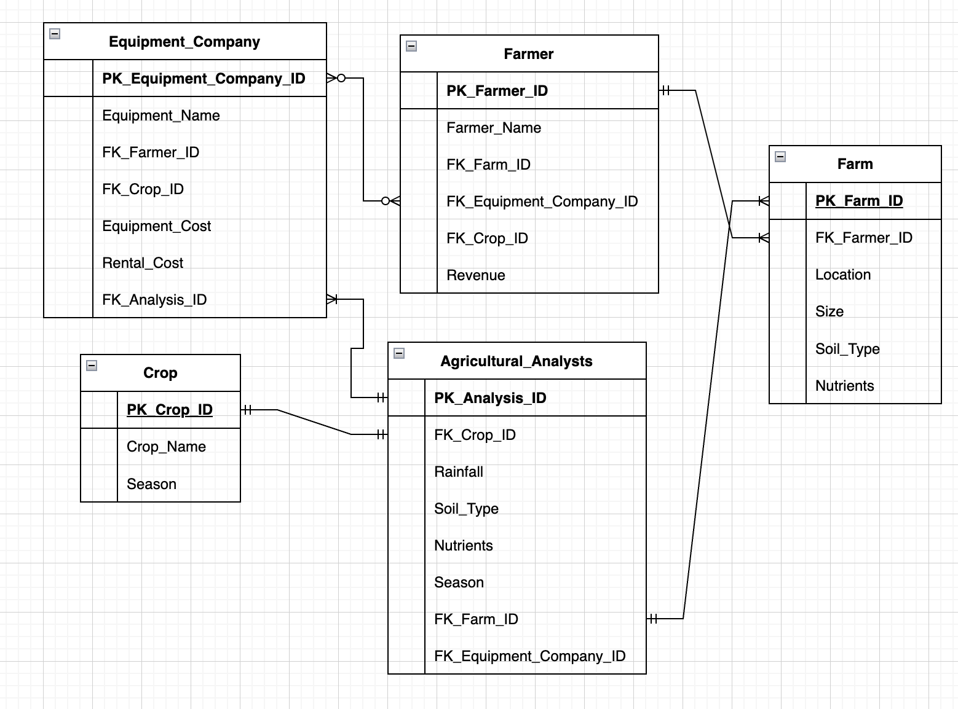
ER Diagram

Slide 6
Other Business Rules & Facts
A Farmer will have his/her own Farm_ID and Farmer_ID which uniquely identifies himself and the farm.
Each Crop will be identified by a Crop_ID.
Equipment Selling company will have relation with Analysis company which would provide data about upcoming farming season and crops in exchange for money.
Analysis company will enrol those farmers and their farms along with their farm details so can make a study report.
Agricultural Analysis company will have Primary Key Analysis_ID and Foreign Key Equipment_ID.
Equipment company will have Foreign Key Farmer_ID which would connect Farmer table and Equipment Table.

Slide 7
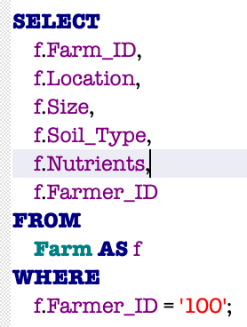
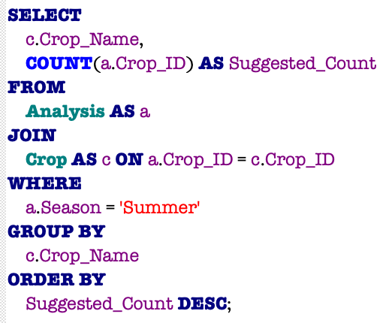
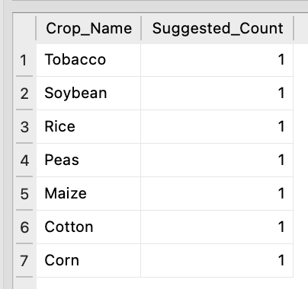
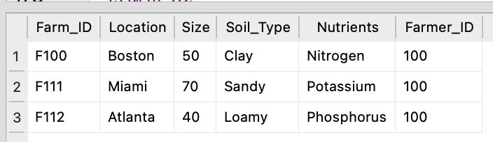
SQL Examples
Query to view all farms of a single farmer
Query to know which crops would be grown in SUMMER season

Slide 8
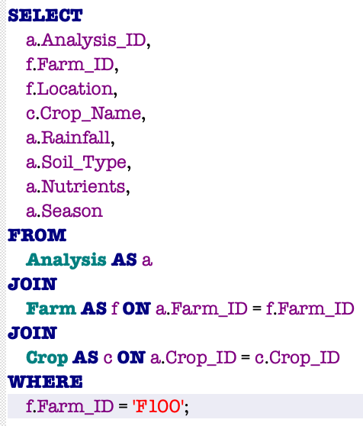
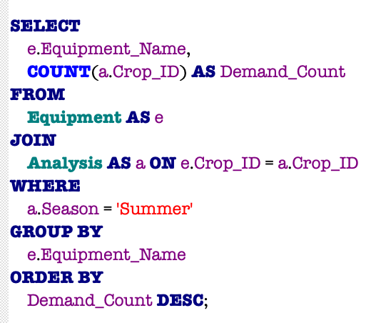
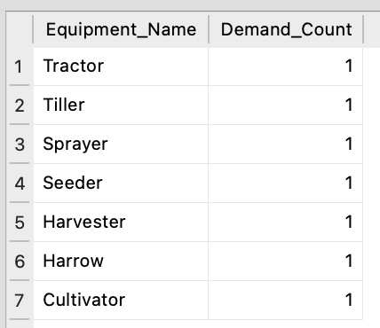
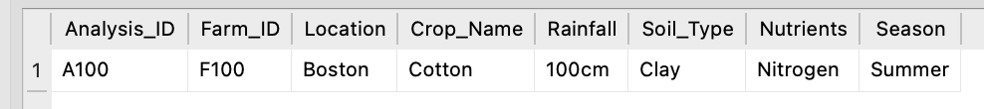
SQL Examples
Query where analysis company publishes result for Farm_ID F100
Query to analyze need of each Equipment for SUMMER season

Slide 9
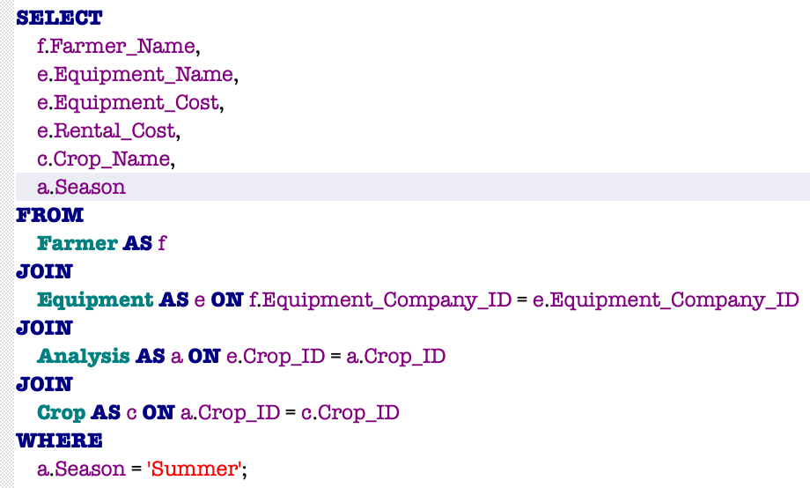
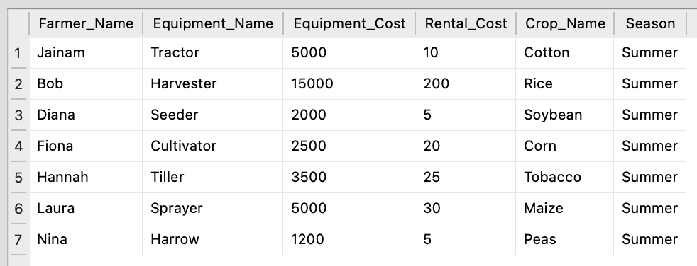
SQL Examples
Query where farmer and dealer deals for equipment

